Slide 1
Toomer ES
Notes:
Good Morning/Afternoon! Today we begin the process of planning our school’s budget for FY23. I know we are all here for the same reason and that is ensuring success for all (enter school name) students. This meeting is to provide an overview of the draft budget and for you to give feedback on the draft budget.

Slide 2
Norms
This is a meeting of the GO Team. Only members of the team may participate in the discussion. Any members of the public present are here to quietly observe.
We will follow the agenda as noticed to the public and stay on task.
We invite and welcome contributions of every member and listen to each other.
We will respect all ideas and assume good intentions.

Slide 3
GO Team Budget Development Process
YOUR SCHOOL STRATEGIC PLAN…
is your roadmap and your role.
It is your direction, your priorities, your vision, your present, your future.
Step 1: Data Review
Step 2: Strategic Plan Review
Step 3: Budget Parameters
(Strategic Priorities)
Step 4: Budget Choices
Notes:
Today I will provide an overview of the budget allocations for FY23. We will begin the work of funding the strategic priorities we agreed upon during our strategic review meeting. (IF YOU HAVE NOT DECIDED ON YOUR PRIORITIES, YOU WILL SAY – WE WILL DECIDE ON OUR PRIORITIES AND THEN DISCUSS ALLOCATING FUNDS TO ADDRESS THOSE PRIORITIES).

Slide 4
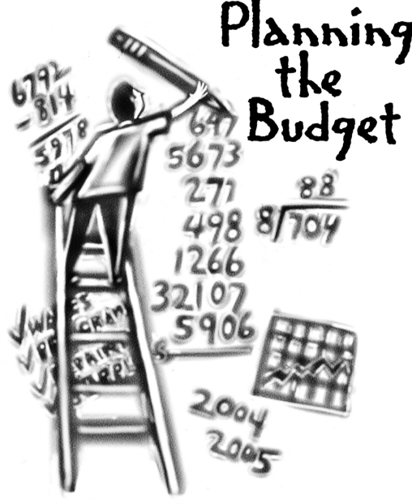
Overview of FY ‘25 GO Team Budget Process
Step 1 Review and Update Strategic Plan and Rank Strategic Priorities
By end of Fall Semester
Step 6 Principals: HR Staffing Conferences Begin
February 26–March 1
Step 3 GO Team Initial Budget Session: Allocation
January 17 – early February
Step 7 GO Team Final Budget Approval Meeting
Budgets Approved by March 15
Step 5
GO Team Feedback Session: Draft Budget Presented & Discussed February – multiple meetings, if necessary
Step 4 Principals: Associate Supt. Discussions and Review
February (supports needed, specific challenges, coaching)
Step 2 Principals: Workshop FY 25 Budget
January 17
GO Teams are encouraged to have ongoing conversations

Slide 5
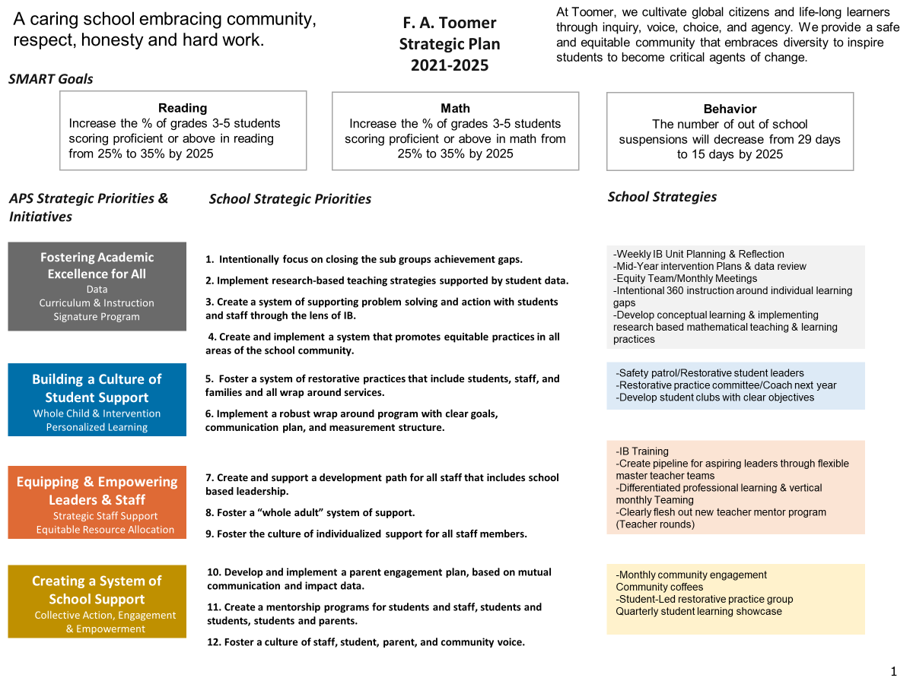
Toomer Strategic Plan
Notes:
You should have a copy of our updated strategic plan (please make copies to be distributed to team).

Slide 6
Toomer
Strategic Plan
Priority Ranking
Higher
1. Intentionally focus on closing the subgroups achievement gaps.
2. Implement research-based teaching strategies supported by student data.
3. Create a system of supporting problem solving and action with students and staff through the lens of IB.
4. Create and implement a system that promotes equitable practices in all areas of the school community.
5. . Implement a robust wrap around program with clear goals, communication plan, and measurement structure.
Lower

Slide 7
FY25 Budget Parameters
FY25 School Priorities | Rationale
Intentionally focus on closing the subgroups achievement gaps | Even though we have improved a great deal in our subgroups the gap is still our area of greatness need.
Implement research-based teaching strategies supported by student data. | With the turnover rate of teachers and the need to hire alternatively certified teacher it has become increasingly important to offer continuous professional development on teaching strategies.
Create a system of supporting problem solving and action with students and staff through the lens of IB. | As an IB school it is necessary to continue our focus on growing our IB practices.
Notes:
Review the priorities that the GO Team has developed and the rationale for these priorities. Feel free to copy this slide if you have more than 3 priorities to account for.

Slide 8
FY25 Budget Parameters
FY25 School Priorities | Rationale
Create and implement a system that promotes equitable practices in all areas of the school community. | As we continue to disrupt the current system of inequities it is necessary to set up a system where this questioning can happen as a part of the function of the school.
Implement a robust wrap around program with clear goals, communication plan, and measurement structure. | In a school community with such diversity wrap around services must be clearly accessible.
Notes:
Review the priorities that the GO Team has developed and the rationale for these priorities.

Slide 9
Discussion of
Budget Allocation

Slide 10
Executive Summary
This budget represents an investment plan for our school’s students, employees and the community as a whole.
The budget recommendations are tied directly to the school’s strategic vision and direction.
The proposed budget for the general operations of the school are reflected at $7,414,966
This investment plan for FY25 accommodates a student population that is projected to be _439 students, which is a increase/decrease of -11 students from FY24.
Notes:
Here’s a few highlights for our budget this year – read executive summary

Slide 11
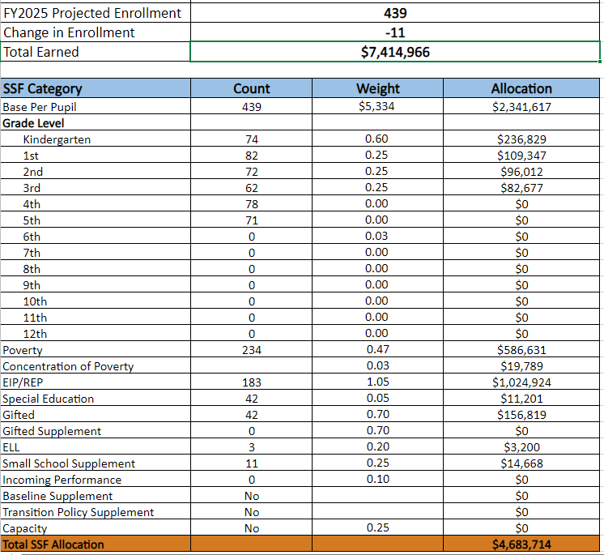
School Allocation
Notes:
Additionally, we received money for signature programming, turnaround, Title I and FTE Allotments.

Slide 12
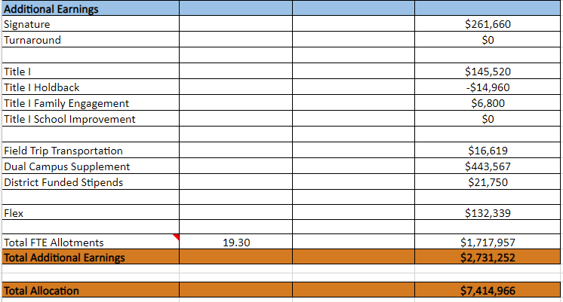
School Allocation
Notes:
For FY23, APS is continuing to increase equity within the District and the flexibility principals have in regards to our schools budgeted funds. The new Student Success Funding Model (SSF) allocates dollars to schools based on the number of enrolled students and receives a funding "weight" based on need. This year, student characteristics were weighted based on:
Grade Level –
K-12
Poverty – Weighted for all Direct Certification enrolled students.
Beginning Performance – Weighted Middle School and High School students entering with beginner’s performance on milestones.
ESOL – Weighted for all ESOL designated students in order to supplement due to ESOL staff being locked.
Special Education - Weighted for all Special Education students.
Gifted – Weighted and measured by number of students in the Gifted Program
Small School Supplement – Weighted for low enrollment schools
ES – 500
MS – 600
HS – 700
As you can see, our projected enrollment for FY23 is _______, we increased/decreased by __________ from last year.
We received the following weights for our student characteristics: (Below is just for the script, principals need to insert their school’s characteristics)
Grade Level
Poverty
Special Education
Gifted
Gifted Supplement
ELL
Small School Supplement

Slide 13
What’s Next?
January
GO Team Budget Allocation Meeting (Jan. 17th-late February)
February
One-on-one Associate Superintendent discussions
Cluster Planning Session (positions sharing, cluster alignment, etc.)
Program Manager discussions and approvals
GO Team Feedback Meeting(s) before principal’s staffing conference
HR Staffing Conferences (February 26 – March 1)
March
Final GO Team Approval Meeting (AFTER your school’s Staffing Conference and BEFORE Friday, March 15th)
Notes:
In February, we will meet again to discuss how the school’s budget has been allocated to support the programmatic needs and FY23 key strategic priorities.
If think we need to continue our budget conversations, we will schedule additional meetings. My goal is to make sure your voices are reflected in our school’s budget.
I will also be meeting with my Associate Superintendent, program managers and other key leaders to go over our budget and to make sure the school is meeting the standards of service and appropriately staffing.
During the week of Feb. 24th -March 2nd , HR Staffing Conferences will be held. At this meeting, I will present my plan for staff utilization, resource distribution and plan for staffing implications.
We will need to approve the budget at the ________ meeting.

Slide 14
Questions?
Thank you for your time and attention.
Notes:
IF YOU FEEL YOUR TEAM IS READY TO APPROVE THE DRAFT BUDGET, PLEASE DO SO. PLEASE REMIND THEM THAT YOU MAY NEED TO MEET WITH THEM AGAIN, IF THERE ARE CHANGES FROM YOUR MEETINGS WITH DISTRICT LEADERSHIP. LET THEM KNOW YOU WILL KEEP THEM INFORMED!!

